Slide 1
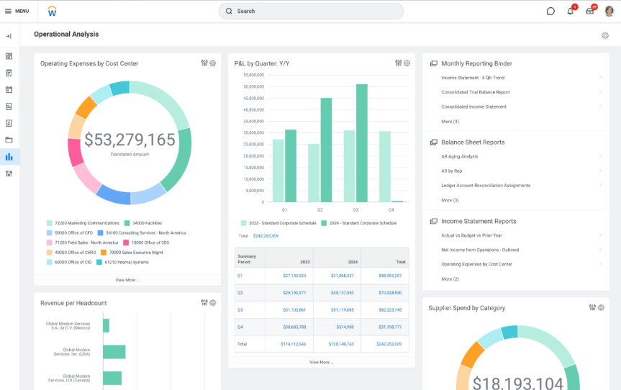
Workday Finance Application

Slide 2
Workday Finance Application
The objective of this project is to leverage AI-driven integration across ERP systems such as Workday to streamline financial operations where HR, payroll, cost centers, and financial reporting intersect. By combining payroll calculation audits and grant cost allocations, and monitoring grant cost allocations to ensure accurate records in ERP systems, this project supports gap analysis and financial risk management.

Slide 3
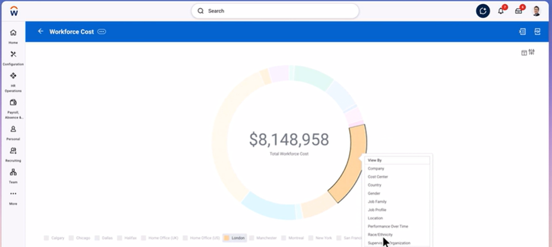
Worker Name
Position
Benefits
Pay
Compensation
Most Recent Payslip

Slide 4
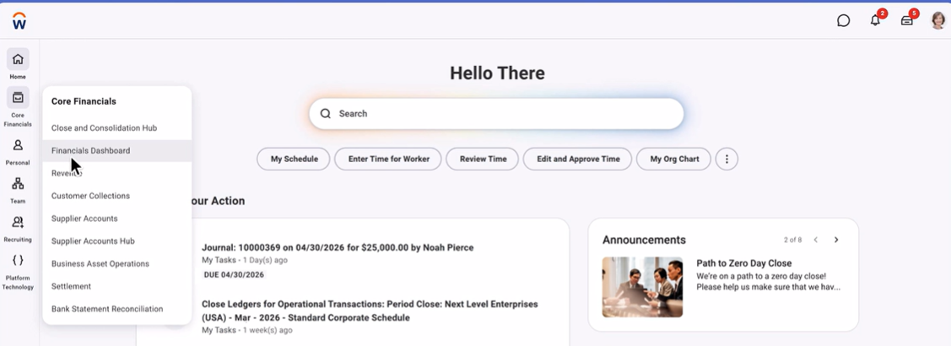
AI connects across ERP systems to audit financial statements
Journal & General Ledger
Revenue & AR Aging Report
Spend Analysis for Invoices
Expense Reports &
AP Aging Report

Slide 5
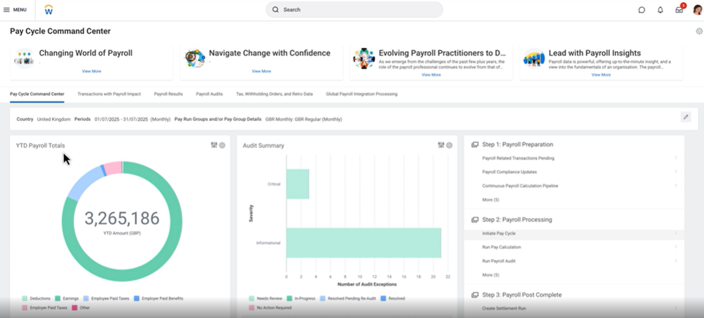
Audit payroll calculation pipelines for compliance

Slide 6
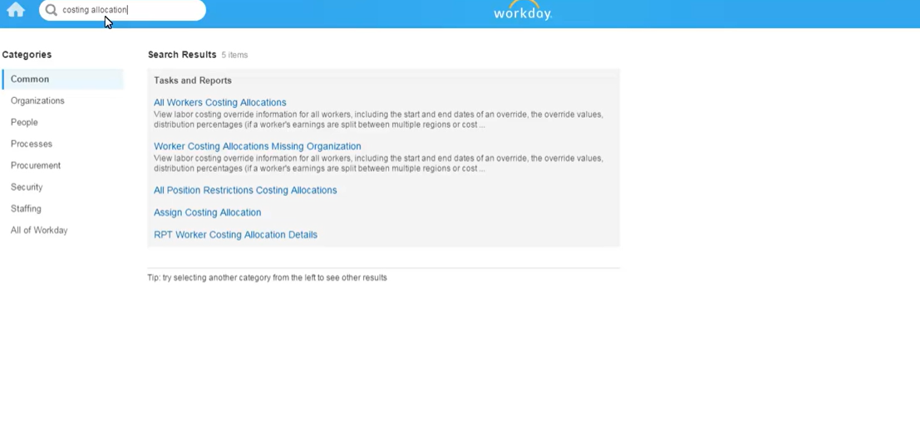
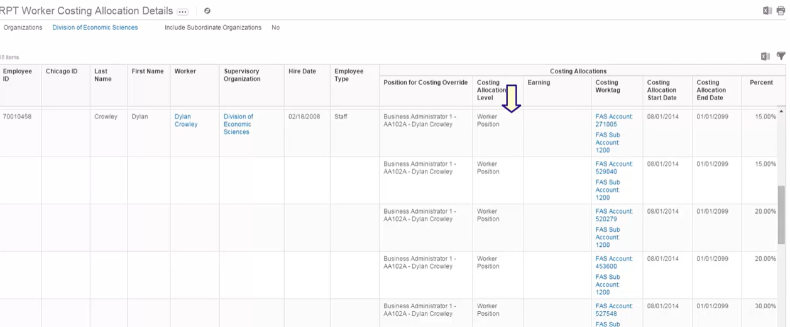
Review all workers costing allocations.

